Slide 1
Olympics
The datasets provide an opportunity to analyze how the Olympics have evolved since early 1960’s. The analysis is focused on figuring out what factors effect the medal tally of a country, including GDP, population and contingent size. Recommendations are made based on the results of the analysis. Based on statistical data obtained from the internet, the medal tally of USA in the 2020 Olympic games is predicted.

Slide 2
Data
Datasets Analyzed:
World Population
World GDP
Athlete Records
National Olympic Committee
Independent Variables:
Number of Medals Won
Dependent Variables:
Country Population
Country GDP
Country number of Athletes Competing
Imported Data from Kaggle

Slide 3
Data Cleanup & Data Transformation
Removed 0 and NaN values from the Athlete dataset
Dropping irrelevant tables (e.g. GDP Table – indicators)
Removing duplicate values
Taking common values of all 3 datasets ( GDP, NOC)
Updating incorrect values (Sigapore1 and Sigapore2)
Merging the 3 datasets
Performing aggregation on the data
(Pivot table used with count as the aggregation function
Count of athletes was not clearly presented)

Slide 4
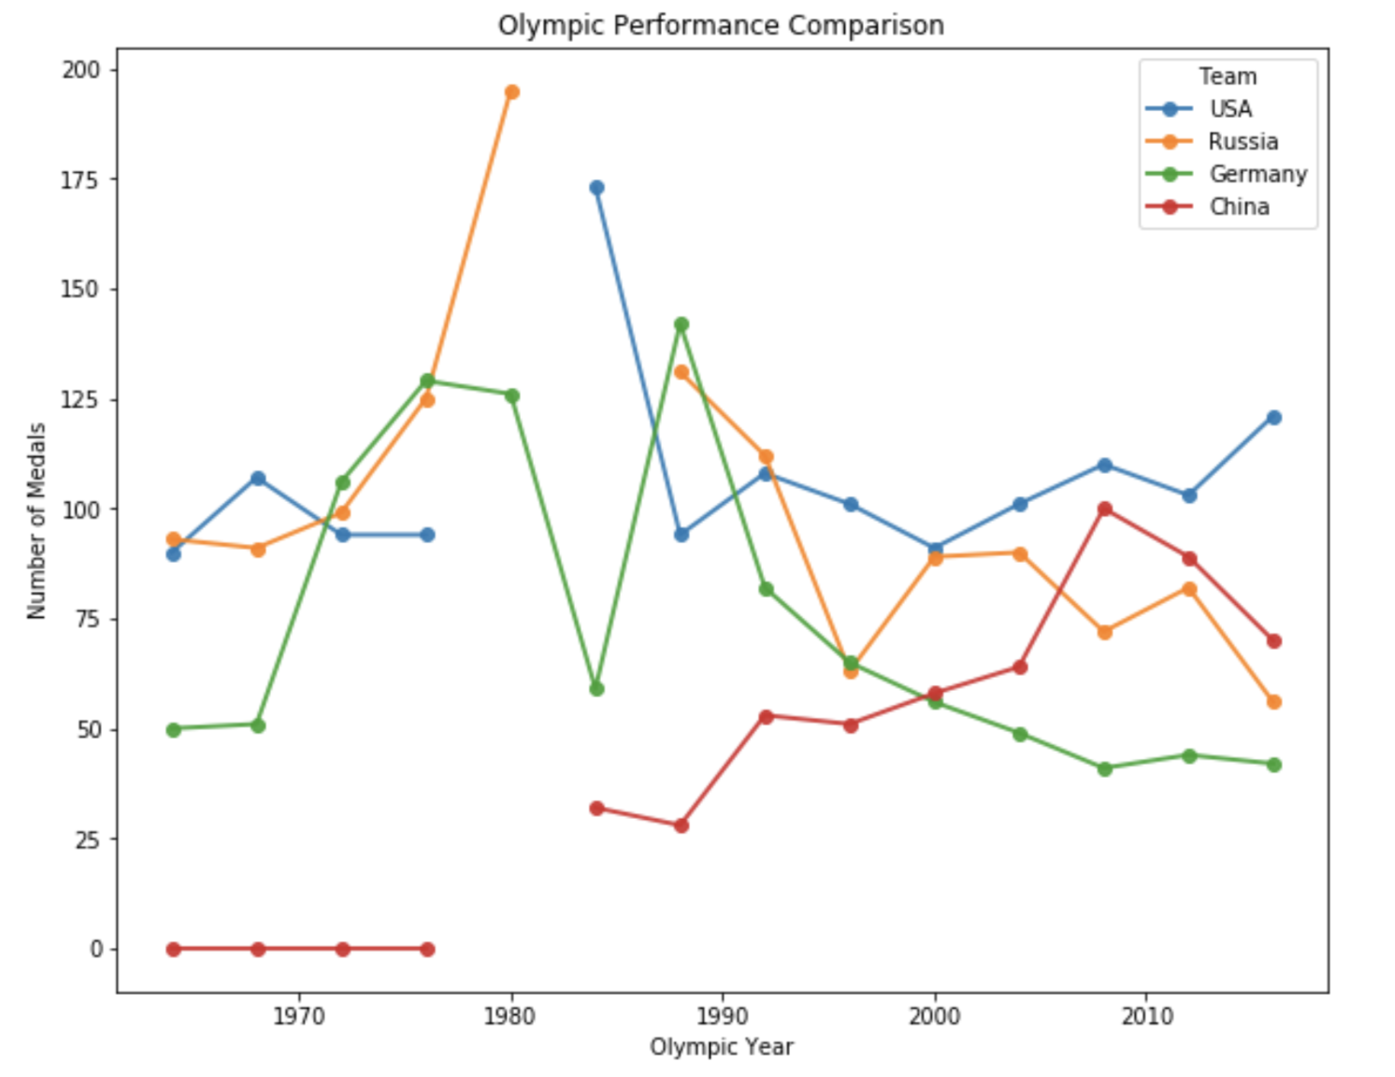
Top 4 countries by medal count
Found the top 4 countries over the last 50 years by total number of medals won.
Gaps are where countries boycotted the Olympics.

Slide 5
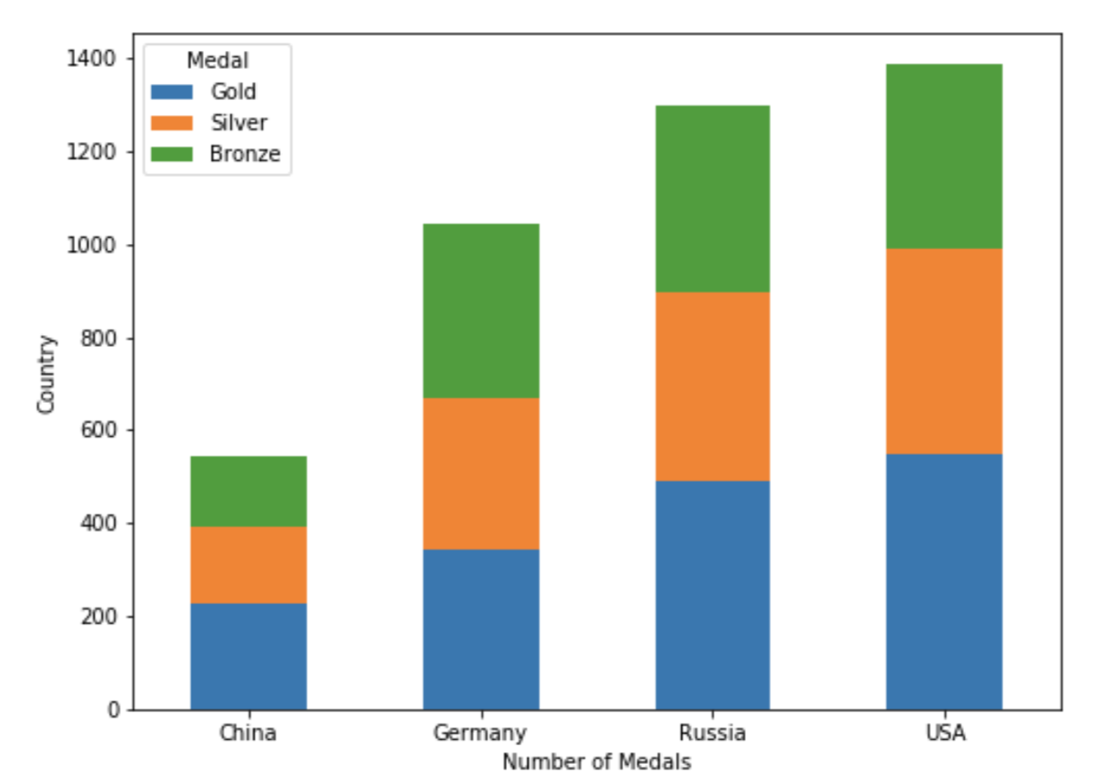
Distribution of Medals
Visualization of Medal distribution of the top 4 countries.
Number of Medals
Country

Slide 6
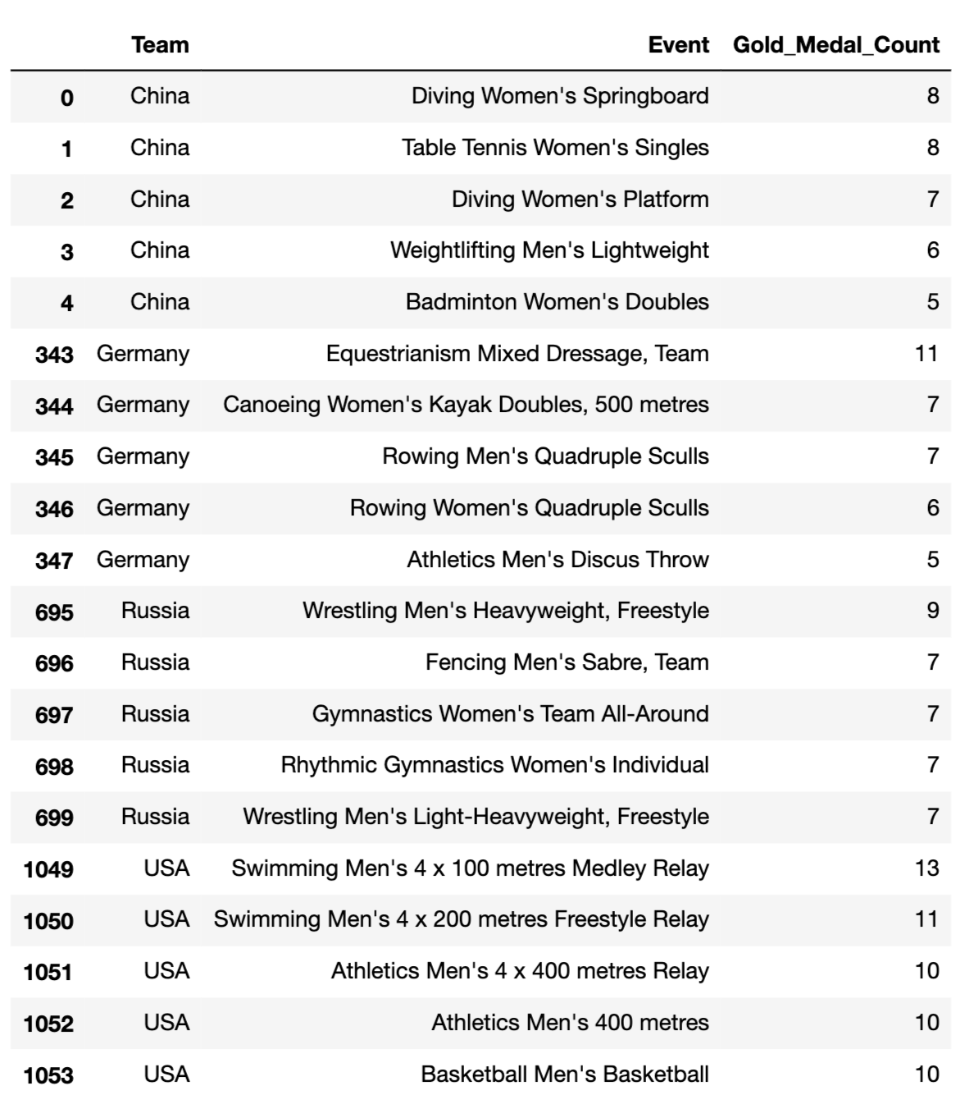
Most Successful Sport

Slide 7
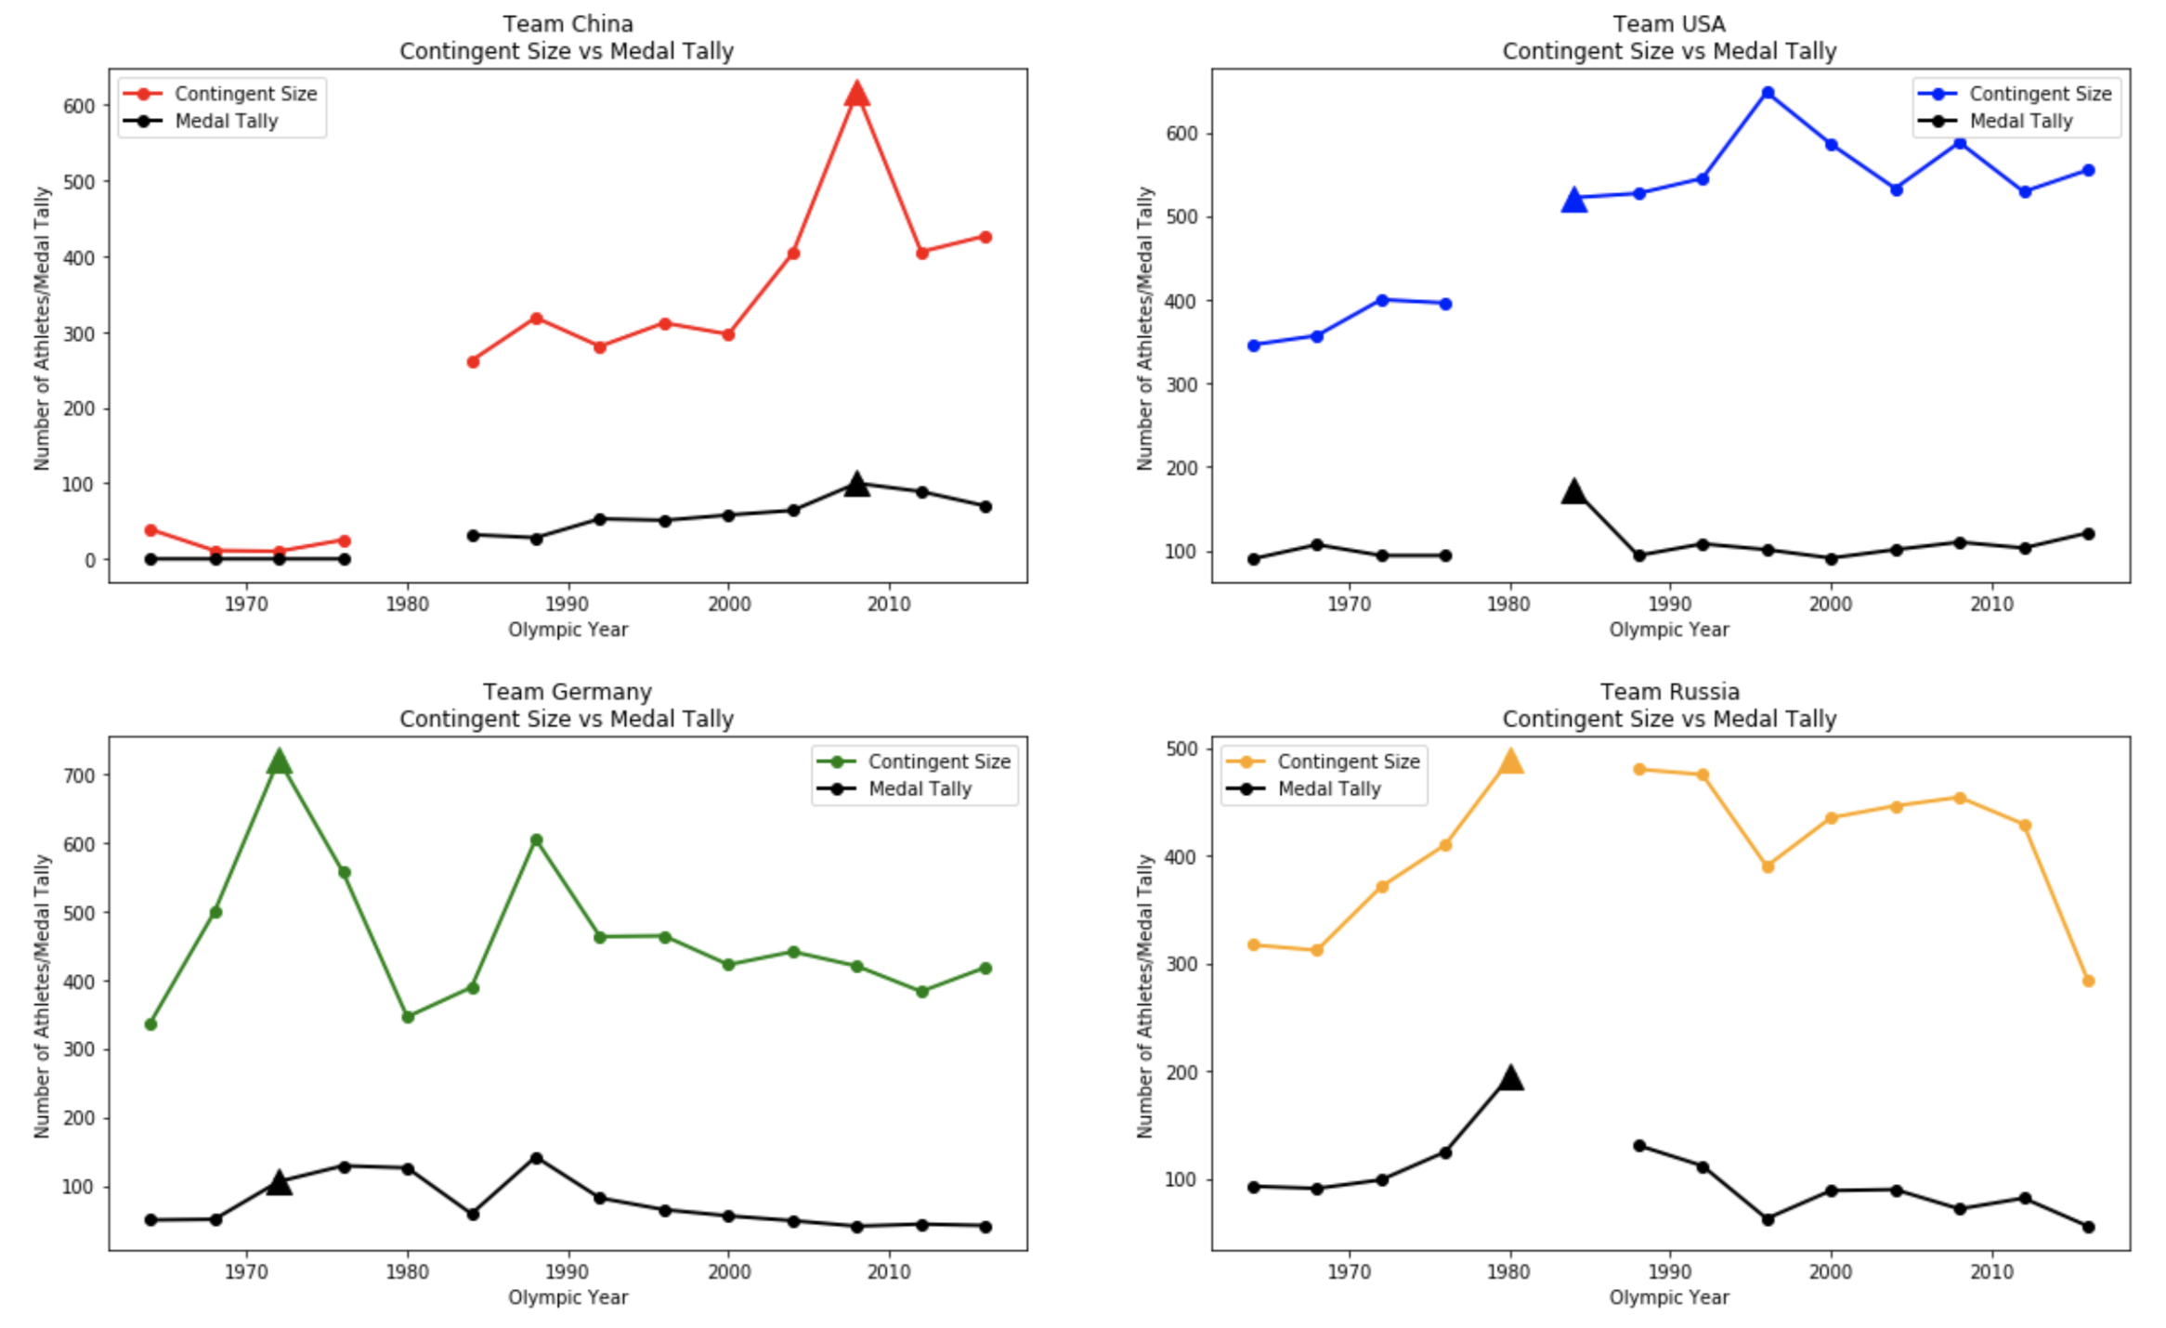
Contingent Size vs Medal Tally
As contingent size increases the medal tally also increases. We investigated this further.

Slide 8
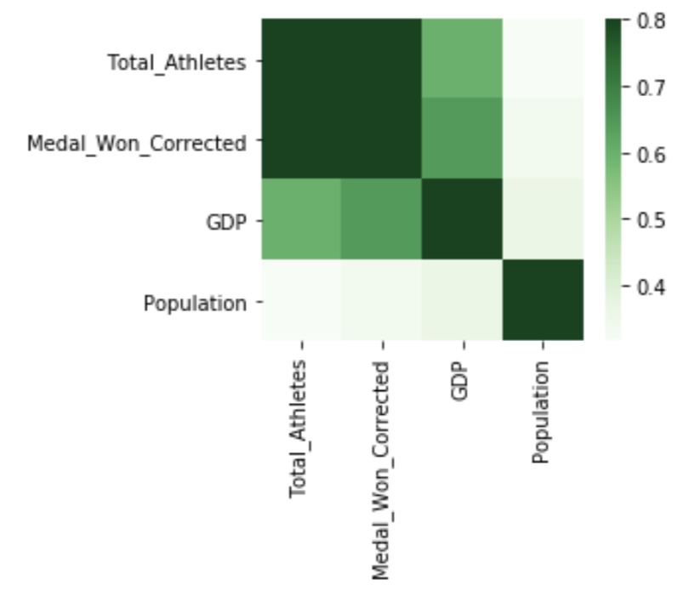
Heat Map
Quantified correlation using a heat map.
Medals Won & Total Athletes: High Positive Correlation
Medals Won & GDP: Moderate Positive Correlation
Medals Won & Population: Weak Correlation

Slide 9
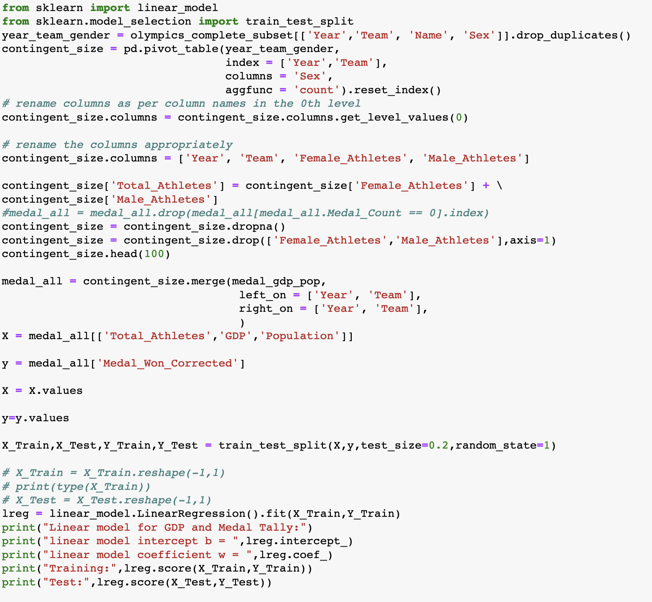
Multi-Variable Linear Model
Predicted Variable:
Medal Count
Dependent Variables:
GDP, Population, Contingent Size
Training: 0.766
Test: 0.772

Slide 10
USA 2020
Dependent Variables
Total Athletes: 550^{*1}
GDP: $22034 Billion^{*2}
Population: 334.5M^{*3}
Independent Variable:
Total Number of Medals: 116
*1 - https://en.wikipedia.org/wiki/United_States_at_the_Olympics
*2 - https://www.statista.com/statistics/216985/forecast-of-us-gross-domestic-product/
*3 - https://www.statista.com/statistics/183481/united-states-population-projection/
How Many Medals?

Slide 11
Recommendations
If a country wants to win more medals they should send more athletes. To do this they will have to invest more into athlete training programs, facilities and spend more money on developing Olympic sports.
Countries with smaller populations can still be very competitive at the Olympics (e.g. Finland).

